Slide 1
USDOT National Transportation Response & Recovery Program and ESF-1 Overview

Slide 2
Emergency Support Functions
ESF #1: Transportation
Department of Transportation
ESF #2: Communications
Department of Homeland Security (DHS)
ESF #3 *: Public Works and Engineering
Department of Defense/U.S. Army Corps of Engineers
ESF #4: Firefighting
Department of Agriculture/Forest Service
ESF #5 *: Emergency Management
DHS/Federal Emergency Management Agency (FEMA)
ESF #6: Mass Care, Emergency Assistance Housing, and Human Services
DHS/FEMA, American Red Cross
ESF #7 *: Logistics Management and Resource Support
DHS/FEMA, General Services Administration
ESF #8 *: Public Health and Medical Services
Department of Health and Human Services
ESF #9 *: Search and Rescue
DHS/FEMA
ESF #10 *: Oil and Hazardous Materials Response
Environmental Protection Agency
ESF #11: Agriculture and Natural Resources
U.S. Department of Agriculture
ESF #12 *: Energy
Department of Energy
ESF #13: Public Safety and Security
Department of Justice
ESF #14 *: Cross–sector Business and Infrastructure
DHS/Federal Emergency Management Agency (FEMA)
ESF #15: External Affairs
DHS
*Indicates DOT as support agency

Slide 3
Emergency Support Function 1
Monitor and report status of and damage to the transportation system and infrastructure
Identify temporary alternative transportation solutions that can be implemented by others
Perform activities conducted under the direct authority of DOT elements
Coordinate the restoration and recovery of the transportation system and infrastructure
Coordinate and support prevention, preparedness, response, recovery, and mitigation activities among transportation stakeholders
Notes:
ESF-1 has 5 mission areas

Slide 4
USDOT Operating Administrations
SECRETARY
DEPUTY SECRETARY
Offices of the Secretary of Transportation
Maritime Administration
Federal Transit Administration
(S-60) Office of Intelligence, Security, and Emergency Response
Other OST Offices
Federal Aviation Administration
Federal Highway Administration
National Highway Traffic Safety Administration
Federal Motor Carrier Safety Administration
Federal Railroad Administration
Pipeline and Hazardous Materials Safety Administration
St. Lawrence Seaway Development Corporation

Slide 5
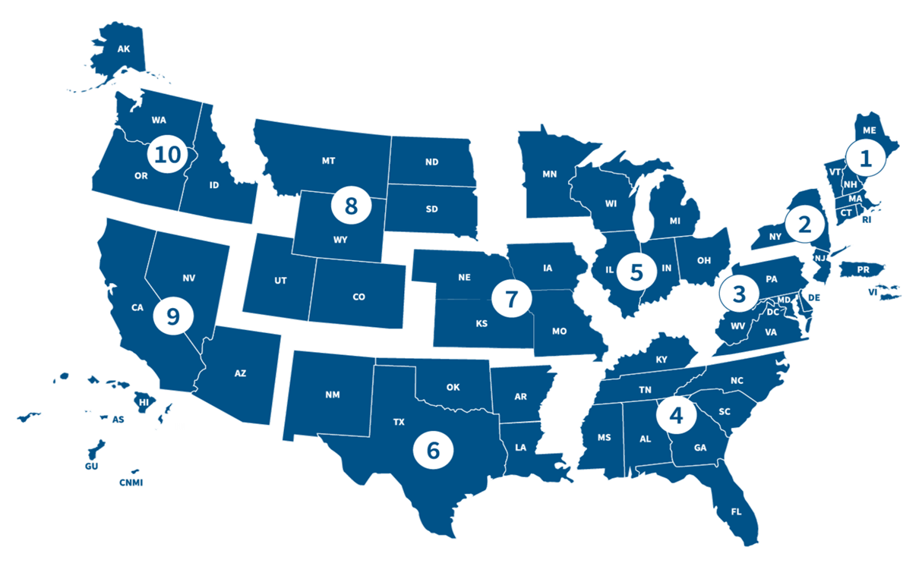
National Transportation Response and Recovery Program
DOT HQ, Washington, DC
Region AK: Anchorage RETCO: Grady Stone
RETREP: Chris Berry
Region 8: Denver
RETCO: Peter Osborn
RETREP: David Plance
Region 7: Chicago
RETCO: Mayela Sosa
RETREP: Nicole Jarvis
Region 1: Boston
RETCO: Peter Butler
RETREP: Ryan Jones
Region 5: Chicago
RETCO: Mayela Sosa
RETREP: Jeff McSpaden
Region 10 Seattle
RETCO: Grady Stone
RETREP: David Lutes
Region 2: New York,
RETCO: Marie Kennington-Gardiner
RETREP: Jeremy McMaster
Region 9: Oakland, CA
RETCO: Grady Stone
RETREP–N: Sharon Cuevas
RETREP–S Vacant
Region 3: Philadelphia
RETCO: Pearlis Johnson
RETREP: Lisa Brennan
Puerto Rico
Region 4: Atlanta
RETCO: Pearlis Johnson
RETREP: Ingrid Allen
Region 6: Fort Worth
RETCO: Rob Lowe
RETREP: Vacant
Notes:
RETREPs are located geographically across the U.S.

Slide 6
USDOT Capabilities
Technical Assistance
NTRRP Personnel
Regulatory Relief
Federal Motor Carrier Waivers
Assets
MARAD Ready Reserve Fleet
Washington Flight Program
Air Navigation Services
Evacuation Liaison Team
Joint Damage Assessment Teams
HazMat Special Permits
Jones Act Waiver Concurrence
Railroad Inspection Relief
Emergency Relief Funding
Operation SafeStor
Mobile Air Navigation Services assets
Oversize/Overweight Permits (facilitate)
Toll Relief (facilitate)
Temporary Flight Restrictions
Notes:
USDOT capabilities include the following assistance, relief and assets.

Slide 7
NTRRP Activities
National Special Security Events
Nuclear Security Summit
Major Sports Championships
Activations
COVID-19
Tropical Storm Cristobal
Puerto Rico Earthquake swarm
Hurricanes Dorian, Michael, Florence, Olivia, Lane, Beryl, Isaac, Harvey, Irma, Maria, and Nate response operations
Super Typhoons Mangkhut and Yutu response operations
Puerto Rico recovery operations
Wildfires in CA, ID, OR, and WA
Kilauea Volcano Eruption response
Oroville Dam, CA dam spillway failure
Hurricane Douglas (remotely)
Mauna Loa Volcano Eruption
Atmospheric Rivers
Typhoon Mawar – Guam
Hurricane Hilary
Maui Fires
Exercises
National Level Exercise 2019 – New Madrid Earthquake
Meetings/Conferences
FEMA RISC Meetings
Regional OneDOT Meetings
National Hurricane Conference
Non-Traditional Activities
OS/OW Permitting for MHUs (Louisiana Flooding and Hurricane Recovery in NC and FL)
Notes:
Here are some of the activities supported in the last few years.

Slide 9
CA/NV Atmospheric Rivers
Partner Coordination
NWS Updates
Heavy Rain, Wind, Fog
River cresting/peaking
Burn scars, debris flows
Power Outages
Numerous Road Closures
Evacuation Routes
Lime Transport & Water Quality
Army Corps of Engineers
Dept of Water Resources
Levee breaches/overflows
Dam releases
FAA
Air Operations
Search & Rescue
TFRs, NOTAMs, Safety
Coordination w/ military
GIS Access, inundation models
Cultural Sensitivities
Who owns what
Local vs Highways
Public Messaging
Education/barricades/cones
Economic Impacts (Ag)
Political Awareness
State Air Ops requests FAA
MA vs Agency Authorities
Agency Interrelationships
Deconflict: railroads/local streets, local bridges/dams
Highway Message Boards (VMS) use
FHWA & ER Funds
ER Limits, $700,000 trigger
Quick Release
Strategies to access
ER vs Stafford Act Funds

Slide 10
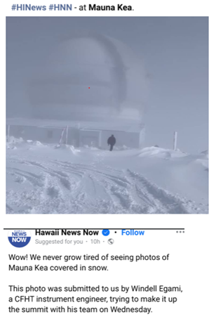
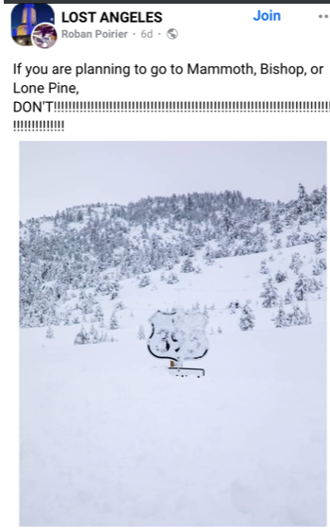

Slide 11
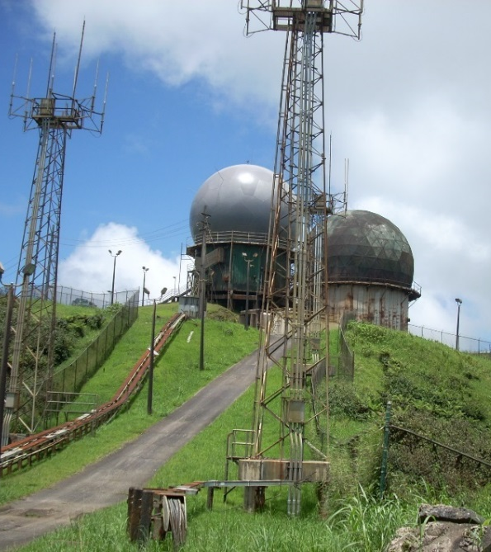
Federal Aviation Administration in Puerto Rico
The FAA’s Center Radar Approach Control (CERAP) and other air navigation assets in the mountains of Puerto Rico, Pico del Este and El Yunque.
Critical air navigation system for the entire Caribbean.
Roadway to both sites critically damaged.
Refueling of the generator at the top of the mountain required helicopter and/or ATV support.
The long-term fix was a combined project with Department of Energy, Department of Agriculture, The Puerto Rico Department of Public Works, and the Puerto Rico electric company (PREPA).
DOE and PREPA laid cabling underground.
USDA responsible for a large section of the roadway.
DOT and Puerto Rico Department of Public Works worked with USDA to plan and fund the roadway.
Coordination resulted in more resilient infrastructure!
Notes:
The next 3 slides show how the RETREPs coordinated on a Puerto Rico event, to assist during a disaster.
Modal Administrations tend to operate independently with most of the coordination being done at the community or municipality planning organizations level.
There have been times that both intra and inter-departmental coordination was necessary to pursue efficiency goals.
During Hurricanes IRMA and MARIA, the roadway leading to the top of El Yunque suffered sever damage, each subsequent rain event resulted in even more damage from mud slides and washouts. The air navigation systems which was responsible for the safe air navigation in the Caribbean was at risk of total failure due to complexities of refueling.
On Nov. 13, 2019, FAA anticipates groundbreaking a project to install
underground power cable infrastructure beginning at approximately ½ mile before
the gate to Highway Forest Service 27 (FS-27) along FS-27 to Pico del Este site.
This work is estimated between $7M and $8M
FAA radio tower supports the following:
o FAA, FBI, US Forest Service, US DEA, US Secret Service, US Coast Guard,
US Custom & Border Protection
o Municipality of Canovanas, Administracion de Tribunales, Department of
Natural Resources, PR Police Department, PREPA, PR Telephone Company –
Claro PR
o Aeronet Wireless, Skytec, Telecinco, PR Wireless
Leveraging relationship built during response, and fostered in the Joint Recovery Field Office, Infrastructure systems identified equities for these roadways in Department of Energy and PREPA – burying cables rather than installing new poles.
Department of Agriculture – Has a field office in the national Park.
Department of Transportation (FAA and FHWA) and the Puerto Rico Public works.
The result of this collaboration is a more resilient infrastructure package.

Slide 12
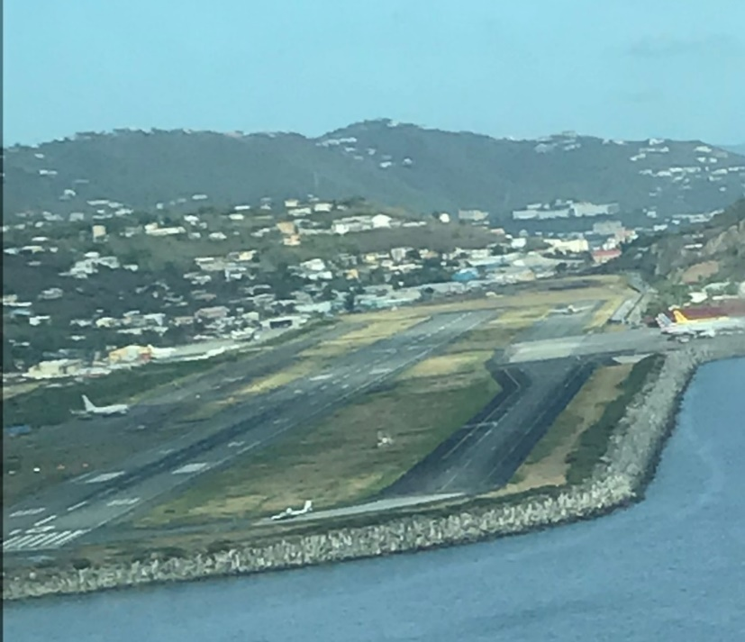
Federal Aviation Administration in the USVI
St. Croix Engine Generator Replacements:
St. Croix Airport (4)
St. Thomas Engine Generator Replacements:
Airport Radar Site (ASR),
Very High Frequency (VHF) Omni-Directional Range (VOR), and
Localizer (LOC)
Airport Traffic Control Tower (ATCT)
Future Disaster :
Two portable generators (1 for St. Croix and 1 for St. Thomas)
Notes:
St. Croix Engine Generator Replacements:
Completed replacement of four generators and power conditioning systems at the St. Croix Airport.
St. Thomas Engine Generator Replacements:
Completed replacement of three generators and power conditioning systems at:
STT Airport Radar Site (ASR),
STT Very High Frequency (VHF) Omni-Directional Range (VOR), and
STT Localizer (LOC).
One generator replacement underway:
STT Airport Traffic Control Tower (ATCT) to begin late October 2019.
Portable Generators:
Two new FAA portable generators (1 for St. Croix and 1 for St. Thomas) have been received for future disaster events.

Slide 13
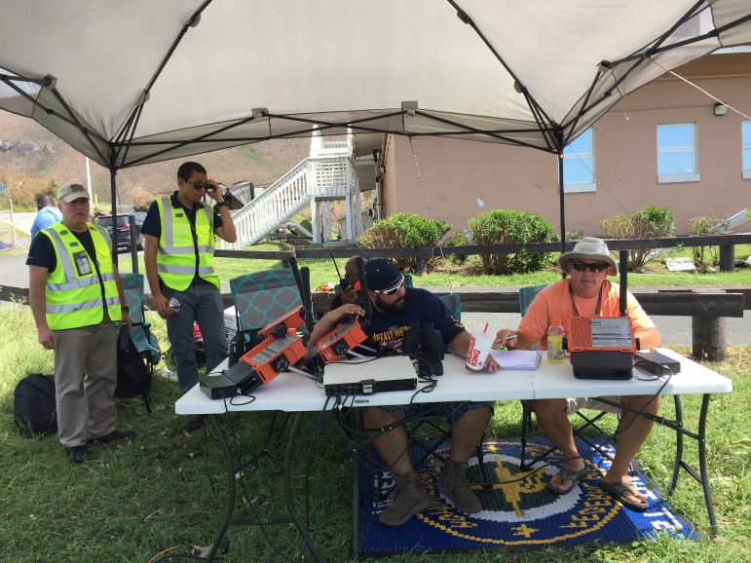
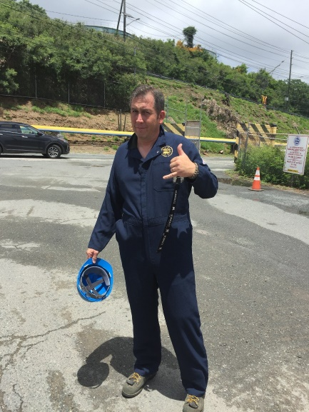
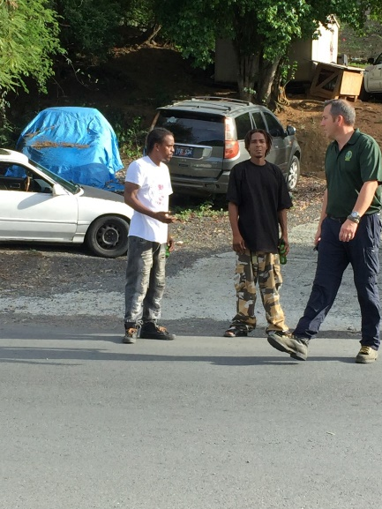
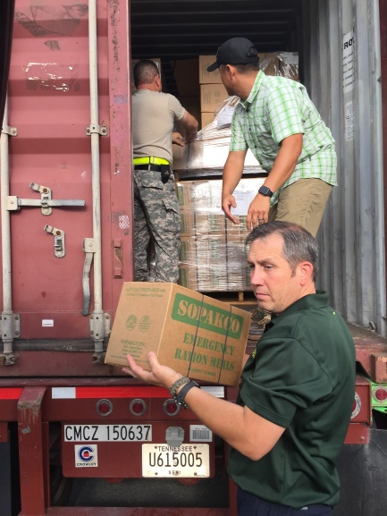
USVI (Saint Thomas) Response (2017)
First hand examples of deployment operations during Hurricane Irma
Power outage before the arrival of the storm created unique challenges
Notes:
Attached are some photos from Hurricane Irma where RETREP Jeremy McMaster deployed with Ron Alexander ESF12 (Energy) pre-storm to St Thomas. We did some reconnaissance at the power station and optimized utilization of the FEMA preposition storage.
The RETREPs work across the territories to support all USDOT administrations and the local communities.

Slide 14
Questions?

Slide 15
Contact Information
DFS-West Regional Emergency Transportation Representatives (RETREP)
Sharon Cuevas – RETREP
Federal Highway Administration
N. California and the Pacific (primary)
AZ, NV (back-up)
202-923-0974 (cell)
e-mail: sharon.cuevas@dot.gov

