Slide 1

FEMA R9 Grants Management Division:
Angelica Saavedra, Director
September 27, 2023

Slide 2
Game Plan to Grant Resilience
Topics We’ll Discuss:
We will:
Get to know the Region 9 Grants Management Division
Increase your awareness of the most common risk areas
Learn about available tools & resources and how we can work together
Our organization and services
Common grant administration pitfalls and challenges
Future collaboration

Slide 3

Who are the Grants Management Division and What we do?

Slide 4
Who are the Grants Management Division and what do we do?
Grants Management Division
Grant Programs Branch
Grant Services Branch
VAYGO

Slide 5



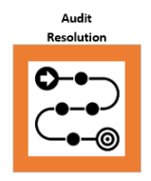
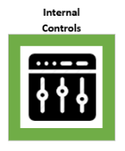

What are our primary functions?

Slide 6

Common Procurement Pitfalls

Slide 7

Procurement Non-Compliance Is Costly
$806,000,000 =
Potentially ineligible contract costs due to non-compliance with procurement requirements within the Public Assistance Program (just one of FEMA’s grant programs)
OIG audit reports issued in FY 2010-2017
69% of the negative findings resulted in recommendations to take the funds back
Number of Negative Procurement Audit Findings FY 2010-2017

Slide 8

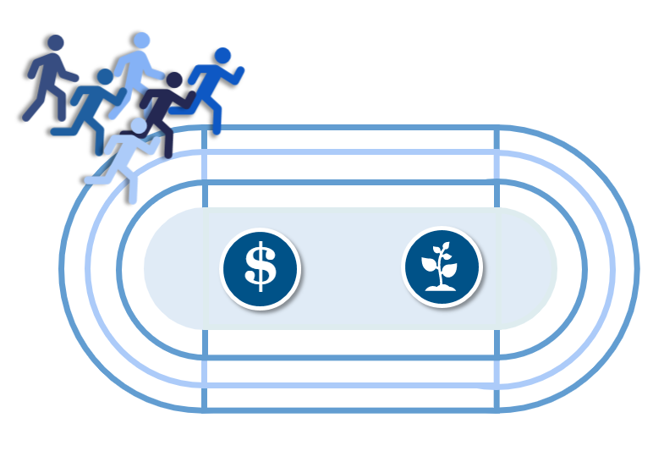
Restricting Full and Open Competition
1
All qualified and responsible sources are eligible to compete without restrictions
Goal: cast net broadly to reach fair & reasonable price from the most qualified contractor
Examples of restricting competition:
  Requiring unnecessary experience
  Excessive bonding requirements
  Using brand names
  Non-competitive contract to contractors on retainer
  Use of geographic preferences

Slide 9


2
Engaging in Sole-Sourcing without documenting permissible exceptions
Five Exceptions to Competitive Procurement:
  Micro-purchases (new)
  The item is available only from a single source​
  Exigency or emergency circumstance
  Inadequate competition
  Awarding agency or pass-through entity approval​

Slide 10
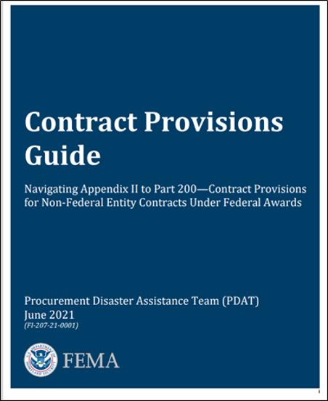
Not including the required contract clauses
3
Contract provisions are required for both state and non-state entities to protect the interests of:
  The entity conducting the procurement
  Federal government
Including, but not limited to:
Termination for cause and convenience
Byrd anti-lobbying
Equal Employment Opportunity (EEO)
Restrictions
Changes
Remedies
Domestic Preferences (new)
Telecommunications (new)
Available at: www.fema.gov/grants/procurement

Slide 11

General Grant Administrative Challenges

Slide 12

General Grant Administrative Challenges
Subrecipient Management
Late Submission of Required Reports
Costs Incurred without Adequate Source Documentation

Slide 13

General Grant Administrative Challenges – Subrecipient Management
Subrecipient Risk Assessments
Subrecipient Agreements
Federal Financial Accountability and Transparency Act (FFATA Submission)
Subrecipient Monitoring

Slide 14

General Grant Administrative Challenges – Late Reports
Federal Financial Reports (FFRs)
Progress Performance Reports (PPRs)
A-133 Single Audit
Various Program-Specific Reports

Slide 15
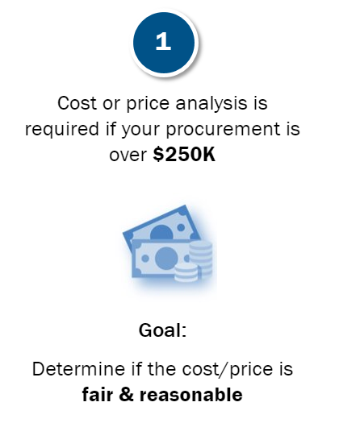
General Grant Administrative Challenges – Costs Incurred
Costs are most disallowed from grants because of inadequate source documentation.
Examples of Source Documentation
Cancelled checks/external source (e.g., financial institution)​
Time and attendance records​
Payroll registers​
Subrecipient award documents​
Receipts​
Invoices and purchase orders​
Executed contracts​
Travel authorization forms/travel vouchers​
Federally approved indirect cost rate agreement​
Fringe benefit rate​

Slide 16

Future Collaboration

Slide 17
Grants Management Division Contact Information
Angelica Saavedra
Grants Management Division Director
Angelica.Saavedra@fema.dhs.gov
Angelica Saavedra
Grant Programs Branch Chief (Acting)
Angelica.Saavedra@fema.dhs.gov
Megan Bryant
Grant Services Branch Chief (Acting)
Megan.Bryant@fema.dhs.gov
Heather Landeros
VAYGO Team Lead (Acting)
Heather.Landeros@fema.dhs.gov

Slide 18
Thank you.

